Slide 1
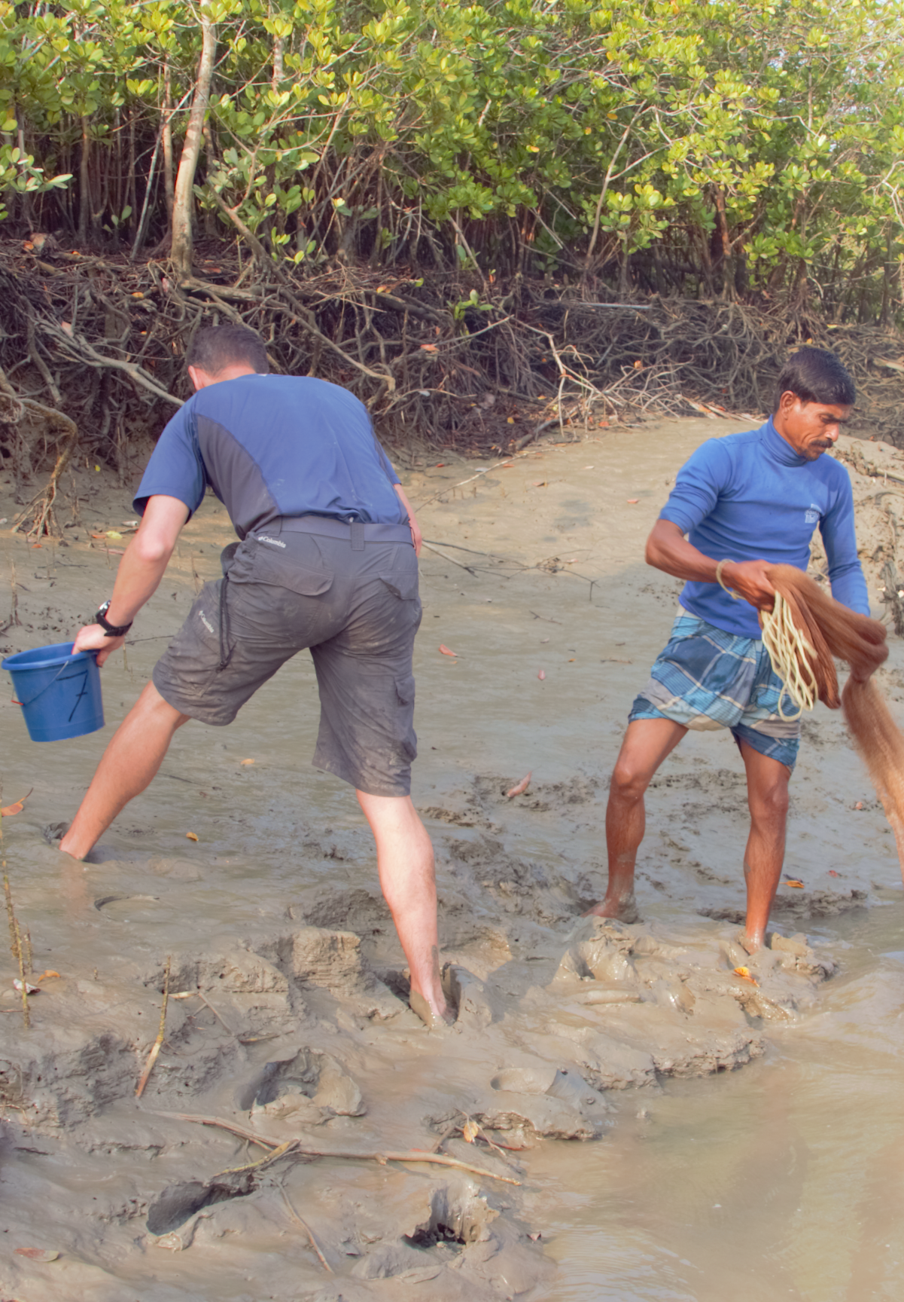


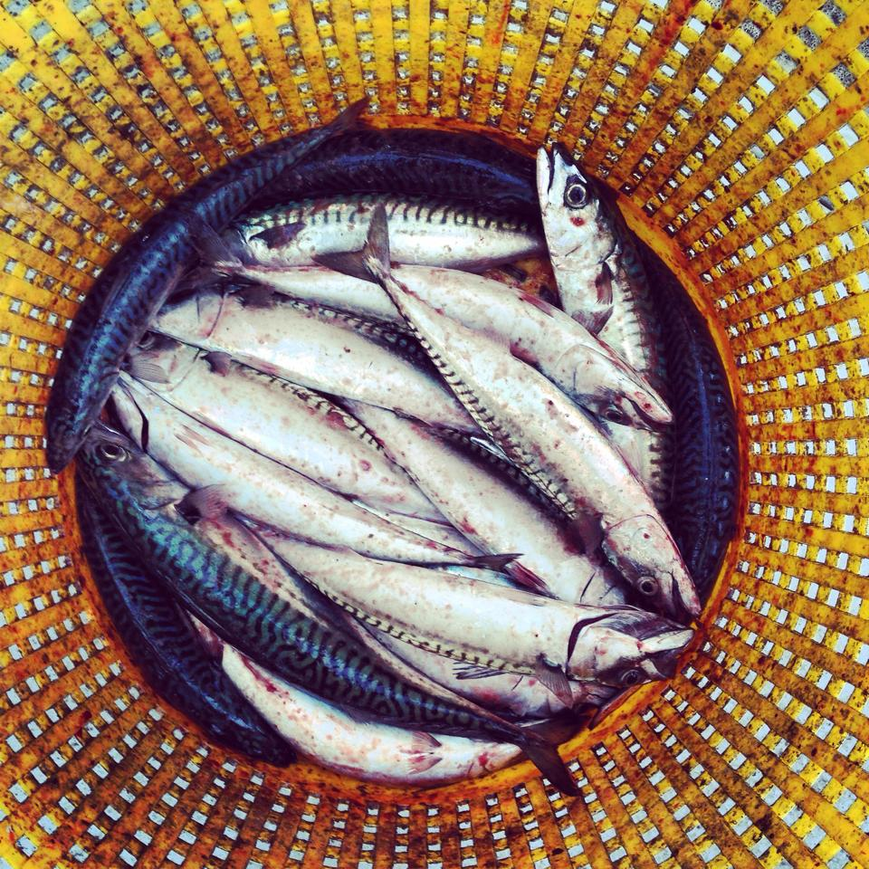
Demystifying statistics – Modelling process recap and making predictions.
Dr Neil Burns – neil.burns@sruc.ac.uk

Slide 2
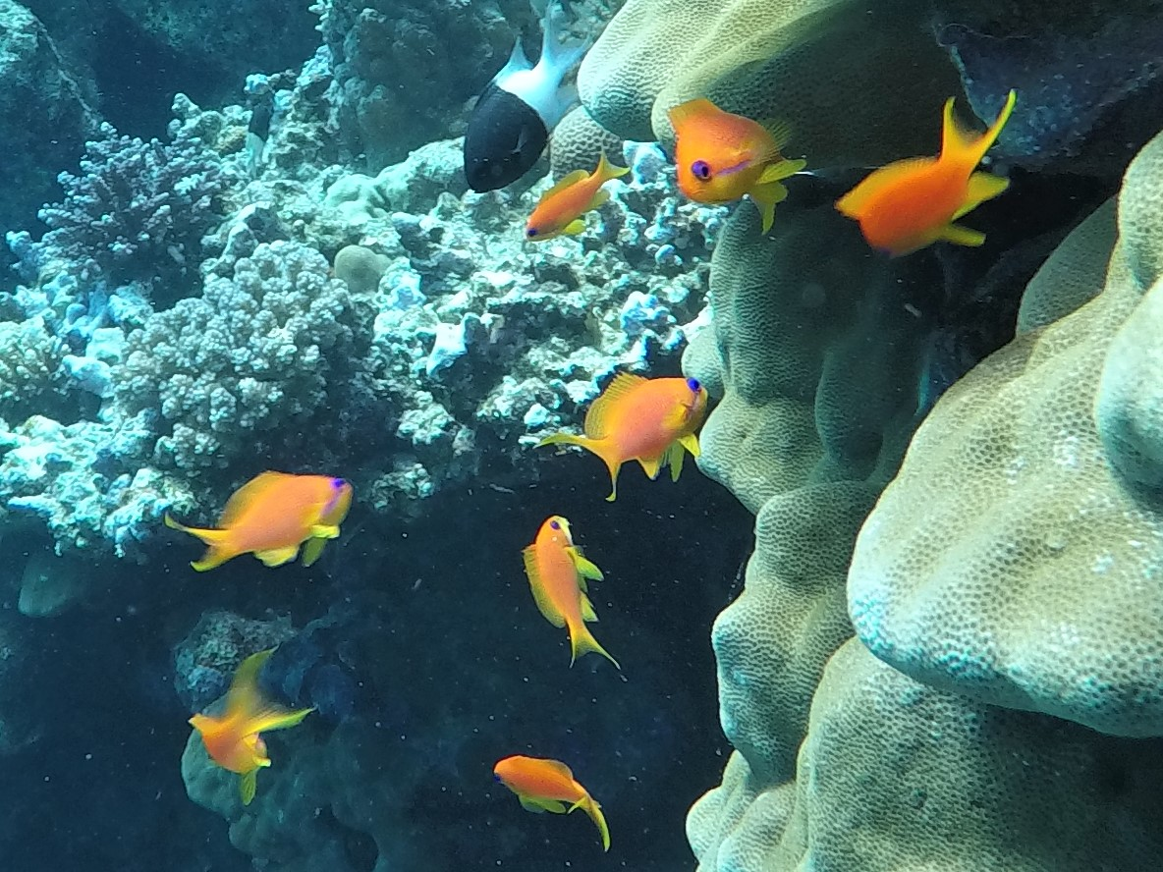
“Course” plan
Session 1:
Basics.
Theoretical introduction.
No sums. Conceptual.
Conceptual model fitting – the recipe.
Session 2:
Some sums.
Data handling, display.
Conceptual model fitting – the recipe.
Finally, a worked example.
Session 3:
Interpreting output from optimal model
Using predictions
With examples – over to you
Model families, error distributions.
Session XX: GAM, GLMM, Random forest,

Slide 3

How this sessions will work
Mix of presentation are R coding
Flit between PowerPoint and R:
You will be practicing some model selection
We will be working through some chunks of R code.
Minimal presentation and shared code
Section headings in R will be highlighted like:
#######################################
##### 1. some sort of title #####
#######################################

Slide 4
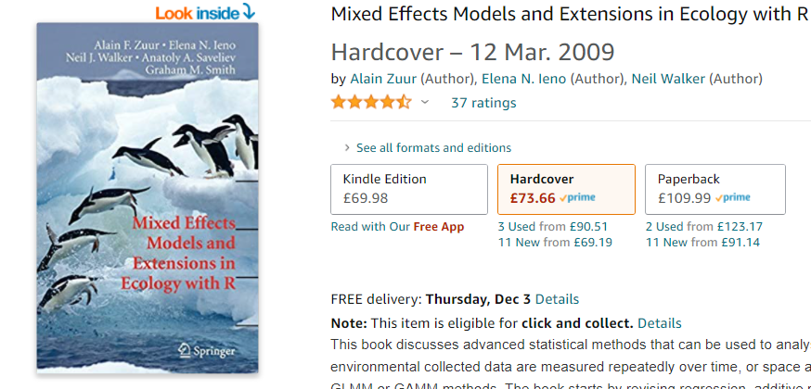
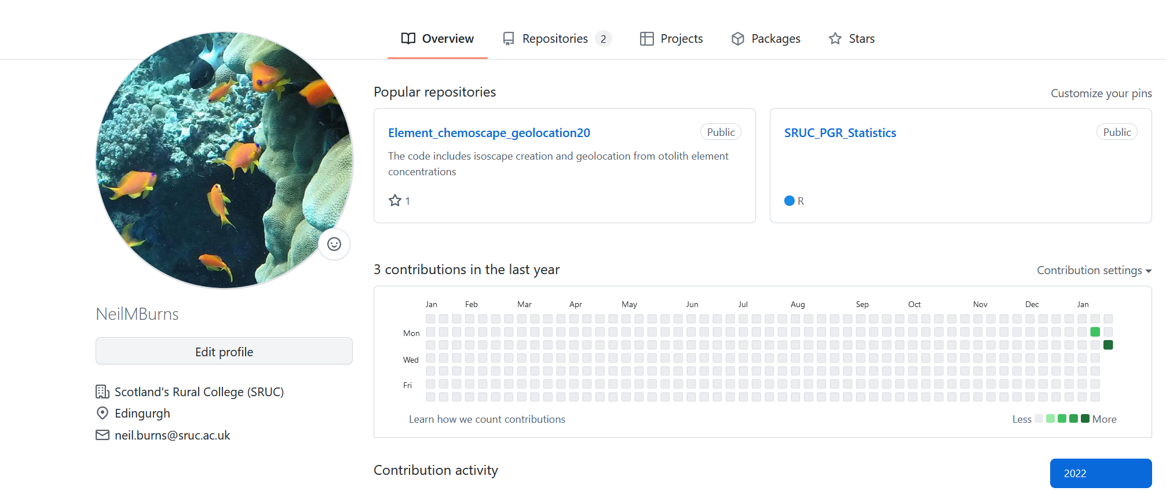
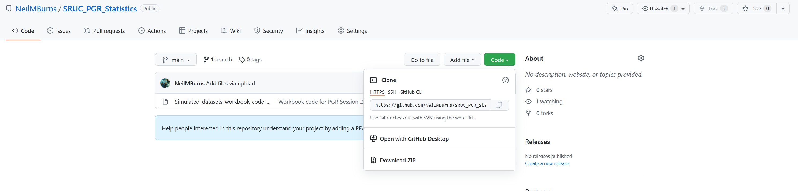

Slide 5

Building useful robots and making inferences
Build and use the model: the recipe
Model selection
Picking the best of a bad bunch.
Model validation
So how rubbish is it?
Interpretation and using your model
By using AIC we are selecting the most “cost” effective model. With cost being measured in degrees of freedom.

Slide 6

Model selection
Using AIC
log-likelihood ratio tests may also be useful
Selection recipe for nested models
Start with the most complex model and work “back” towards the most simple
Use AIC to choose (3 rules)
Simple models are best
Small AIC is best
If these rules contradict (ie the more complex model has smaller AIC) then AIC should be different by more then 2
“I used backwards stepwise model selection to …”

Slide 7
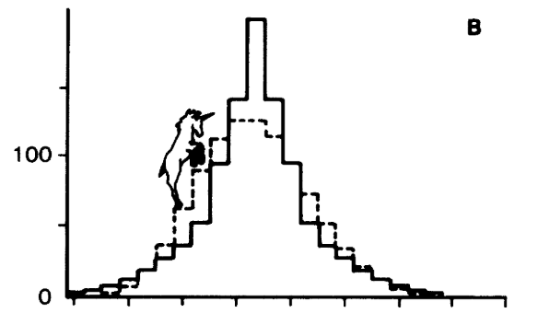
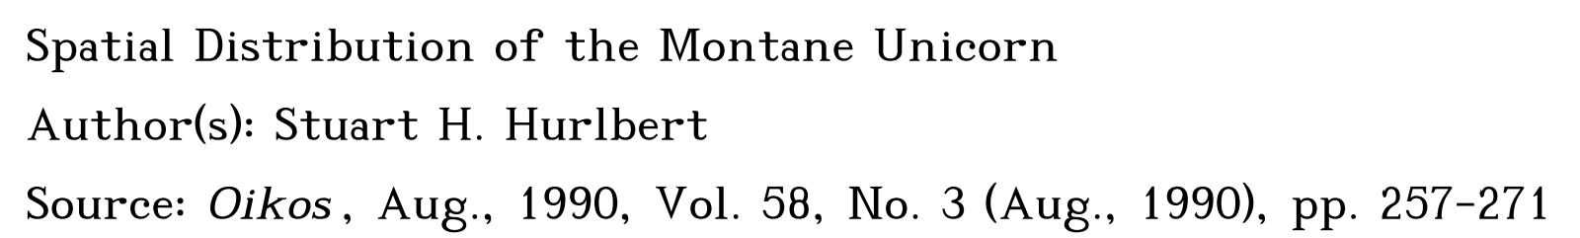
Behavioural data this time
Our toy example
Behavioural response of Montane unicorns ~
response variable (y₁)
+ Mass (kg) (x₁)
+ Diet (x₂)
> 200 and < 800
High Starch or, High Fibre
It’s a number with decimals.
Can be large measured in seconds or milliseconds
Unlikely ever to be less than 0

Slide 8
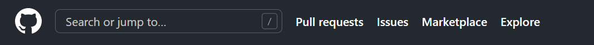
Your go then a worked example in R
#######################################
### Data set 1 - Model selection practice #####
#######################################
#######################################
#### Data set 2 - More complex models #####
#######################################

Slide 9

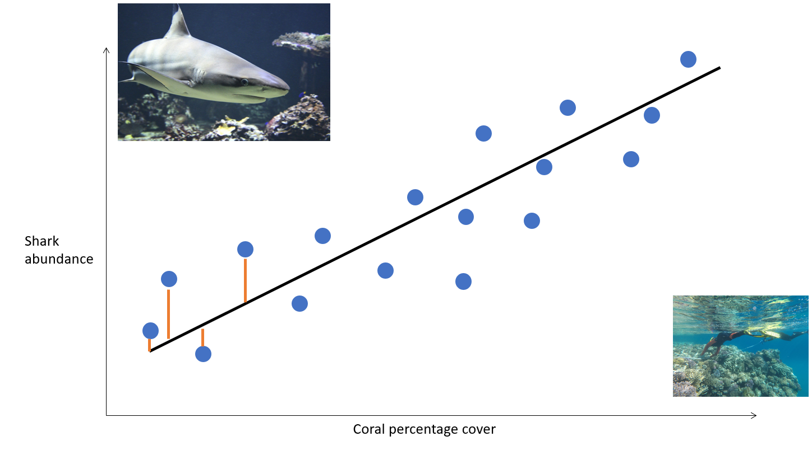
Weirdly it’s not an exact science…
General aim of model validation is:
to have normally distributed residuals
and
no obvious patterns in the residuals
WTF is a residual?

Slide 10
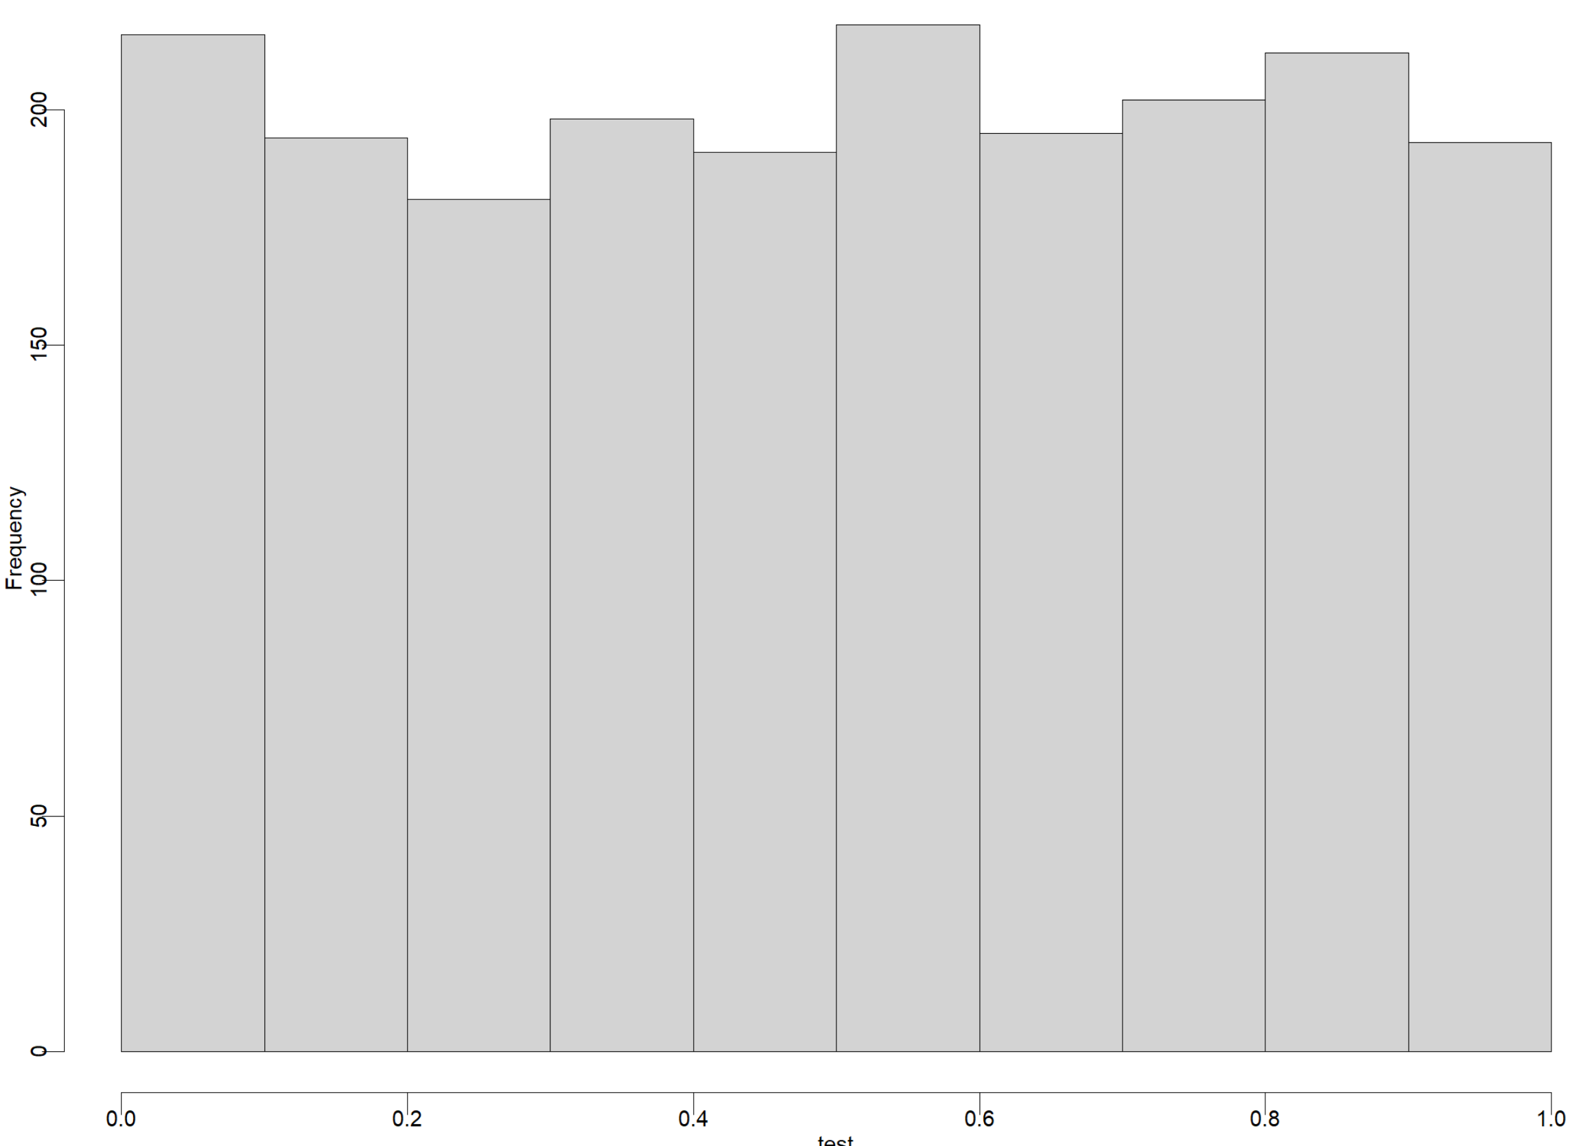
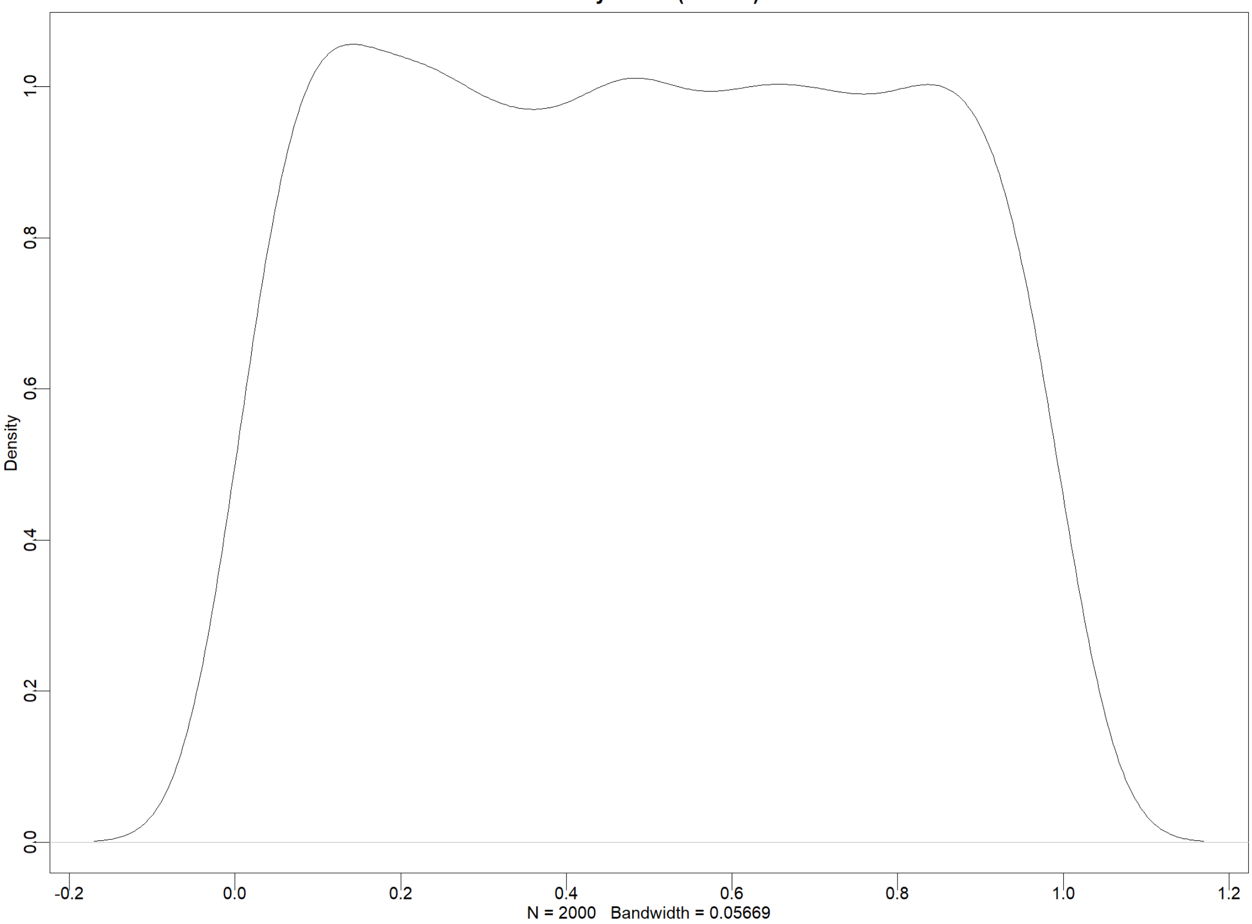

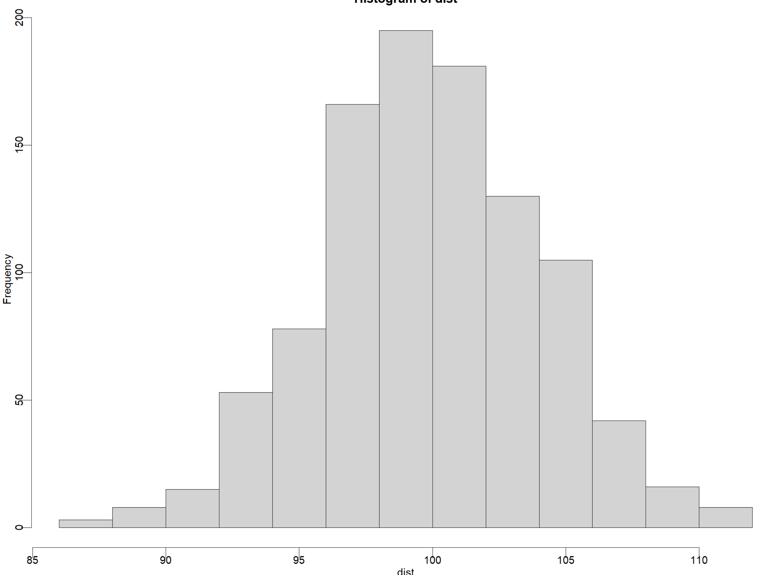
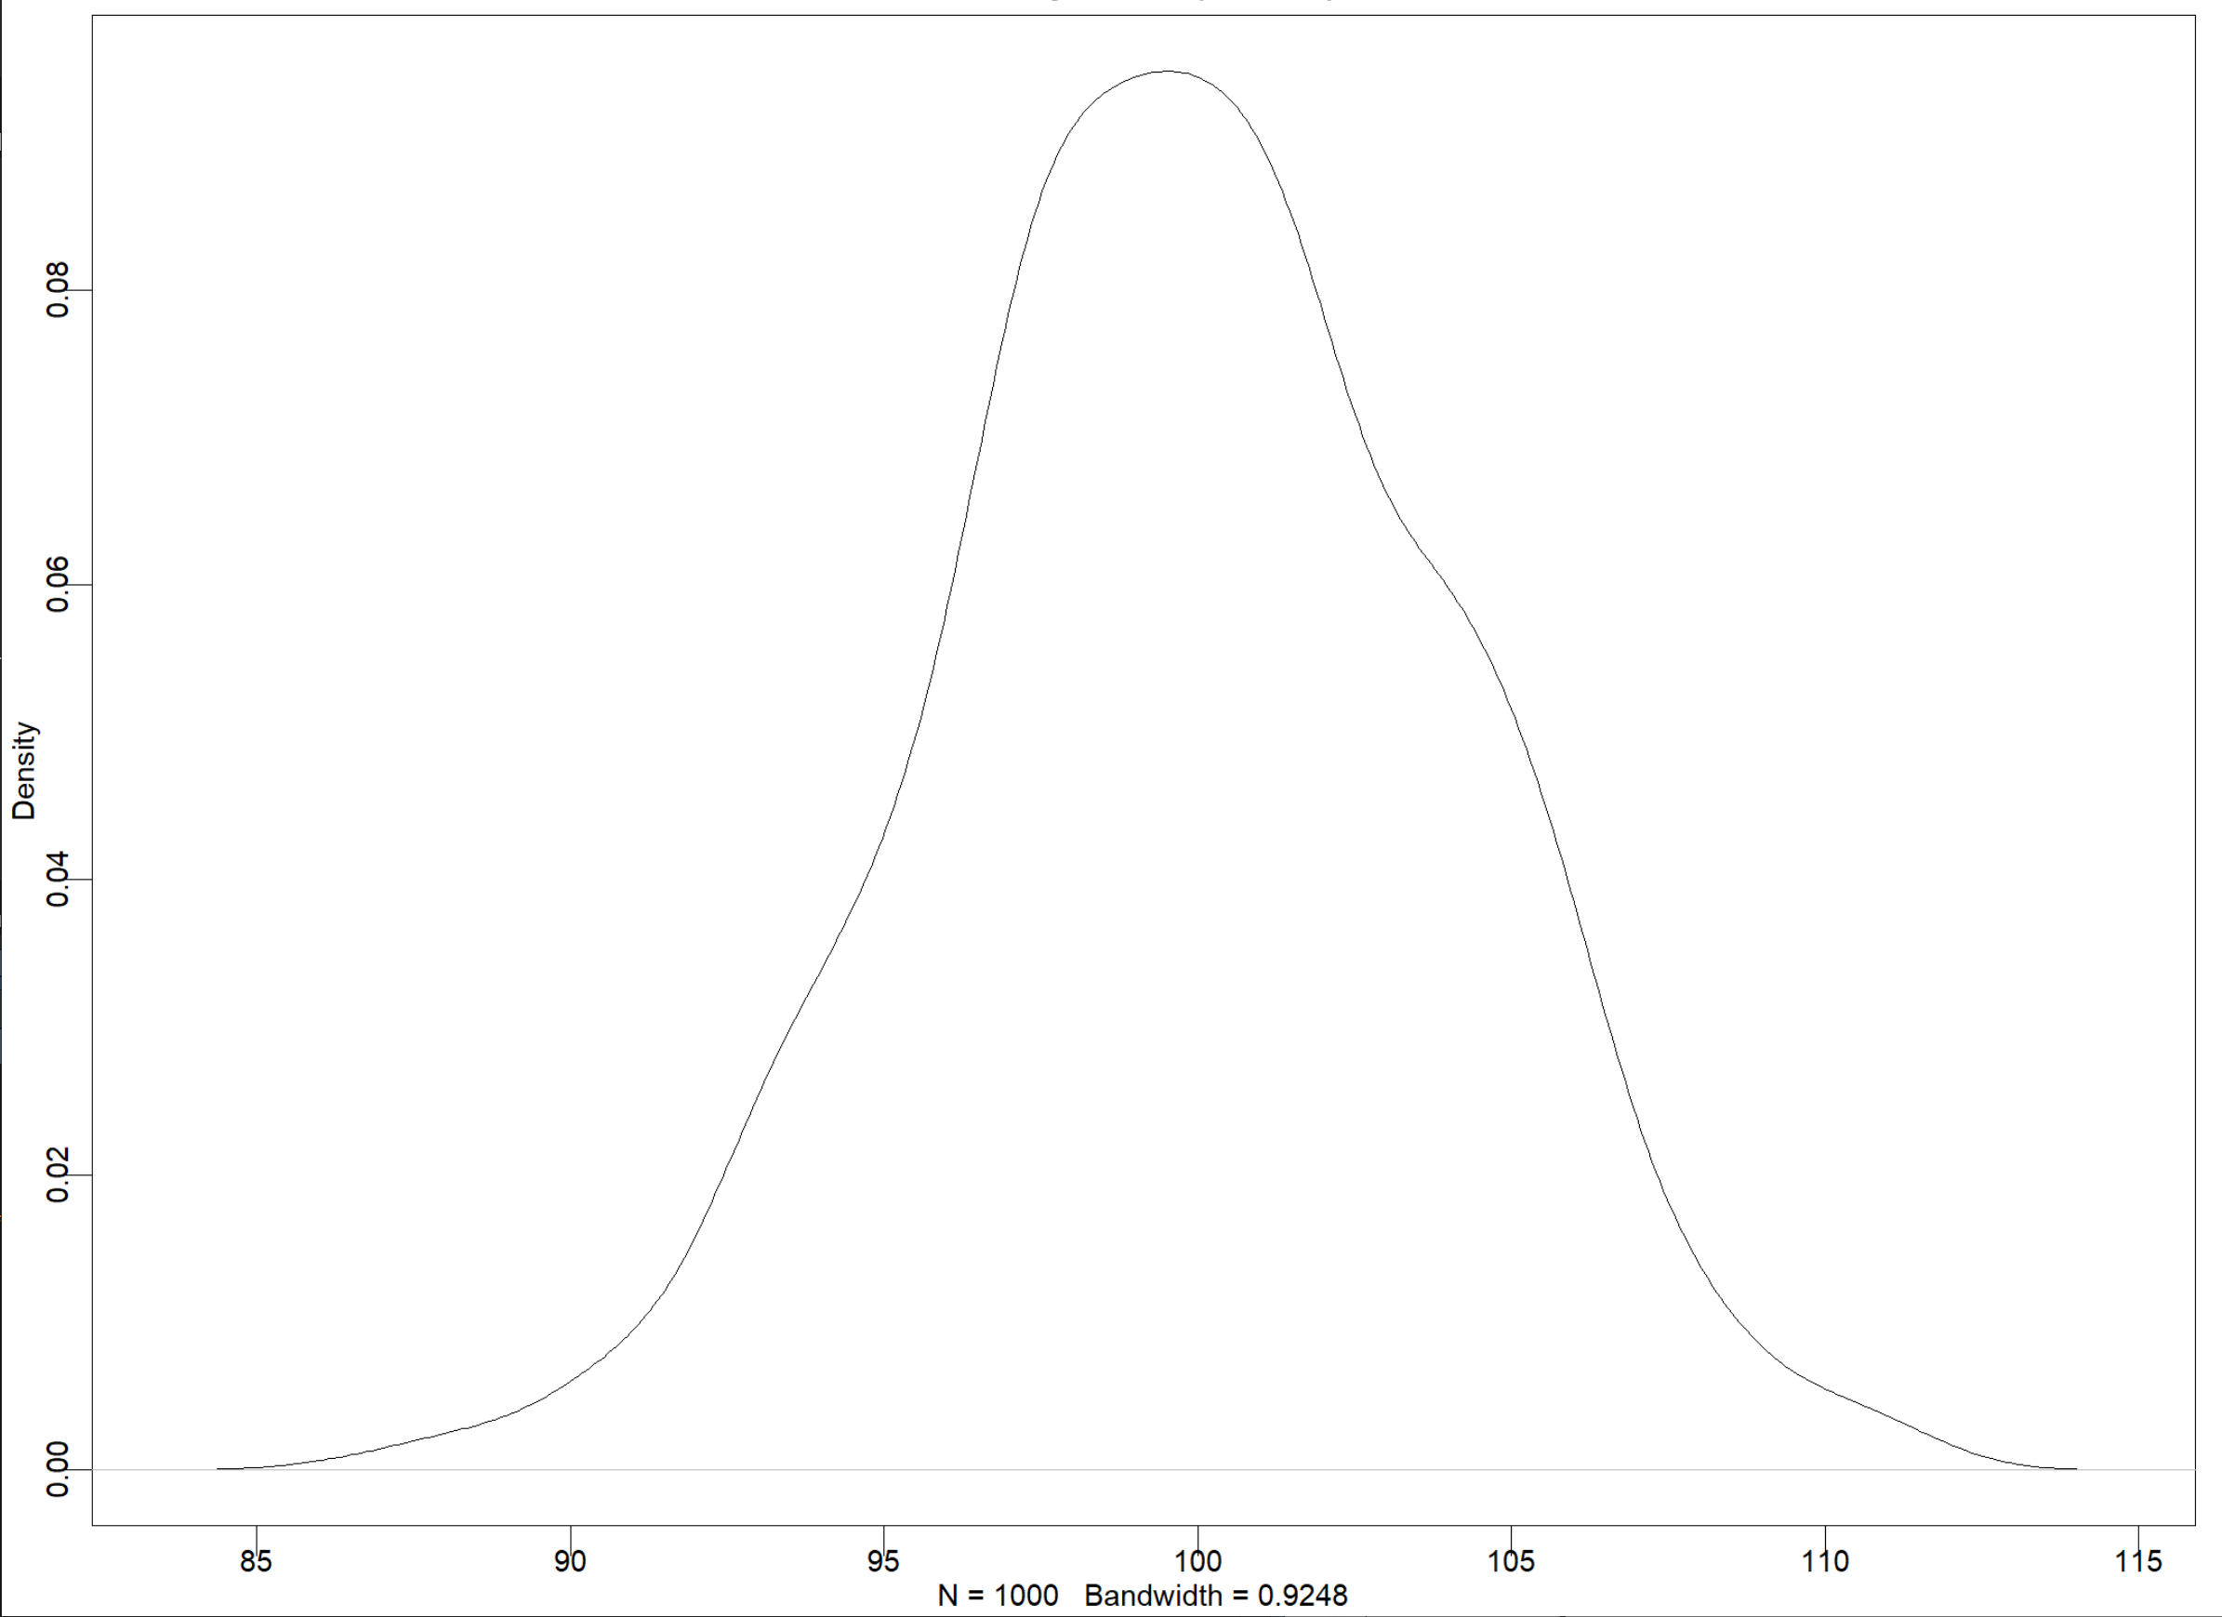
Why assume residuals are distributed normally?
runif(2000,0,1)
replicate(1000, sum(runif(200,0,1)))

Slide 11
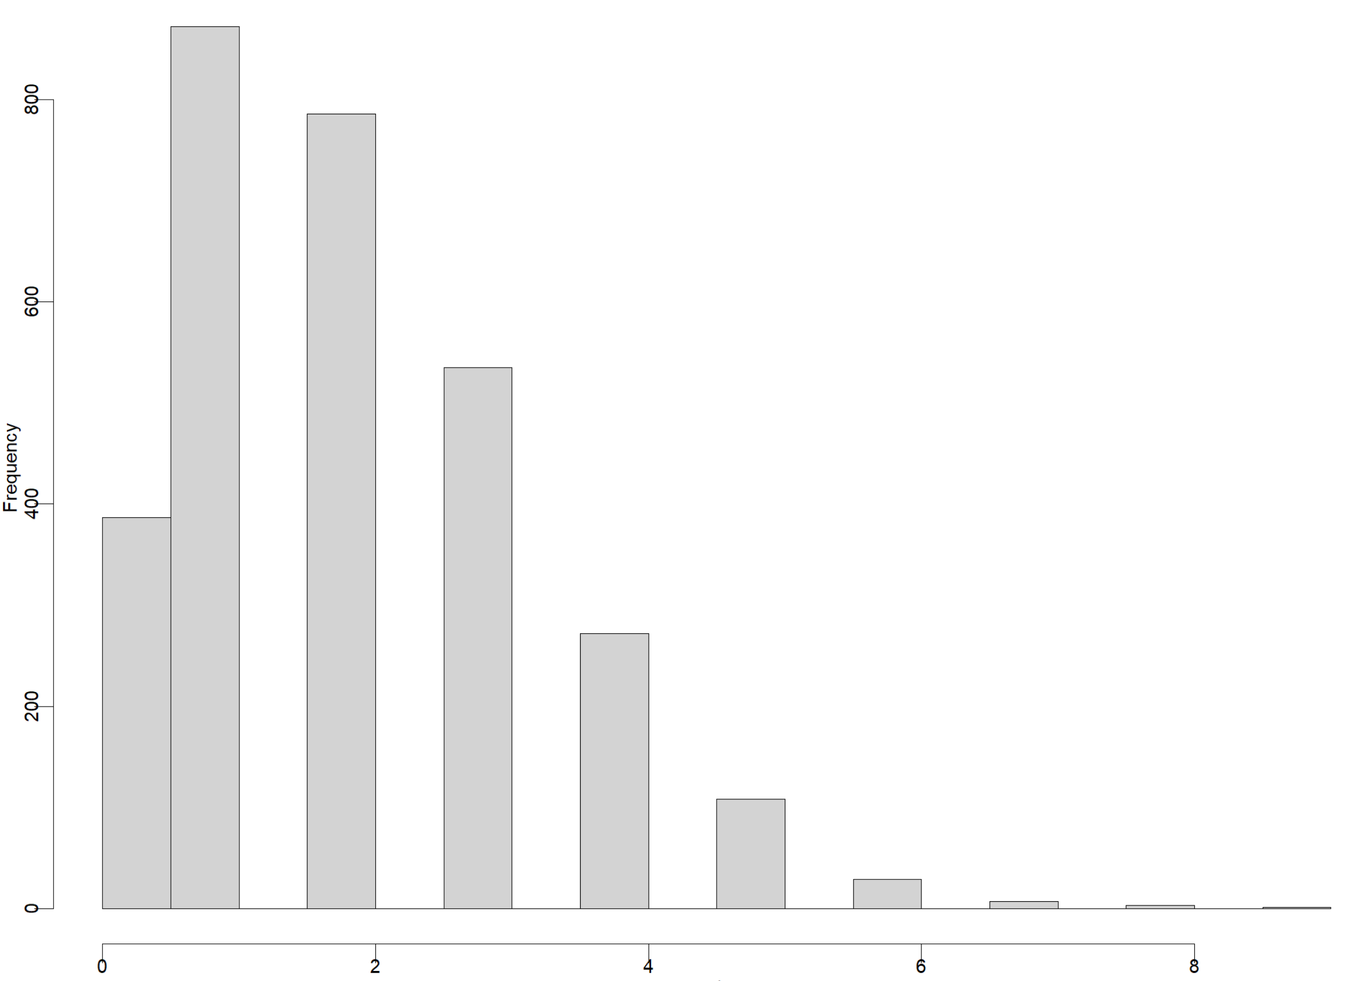
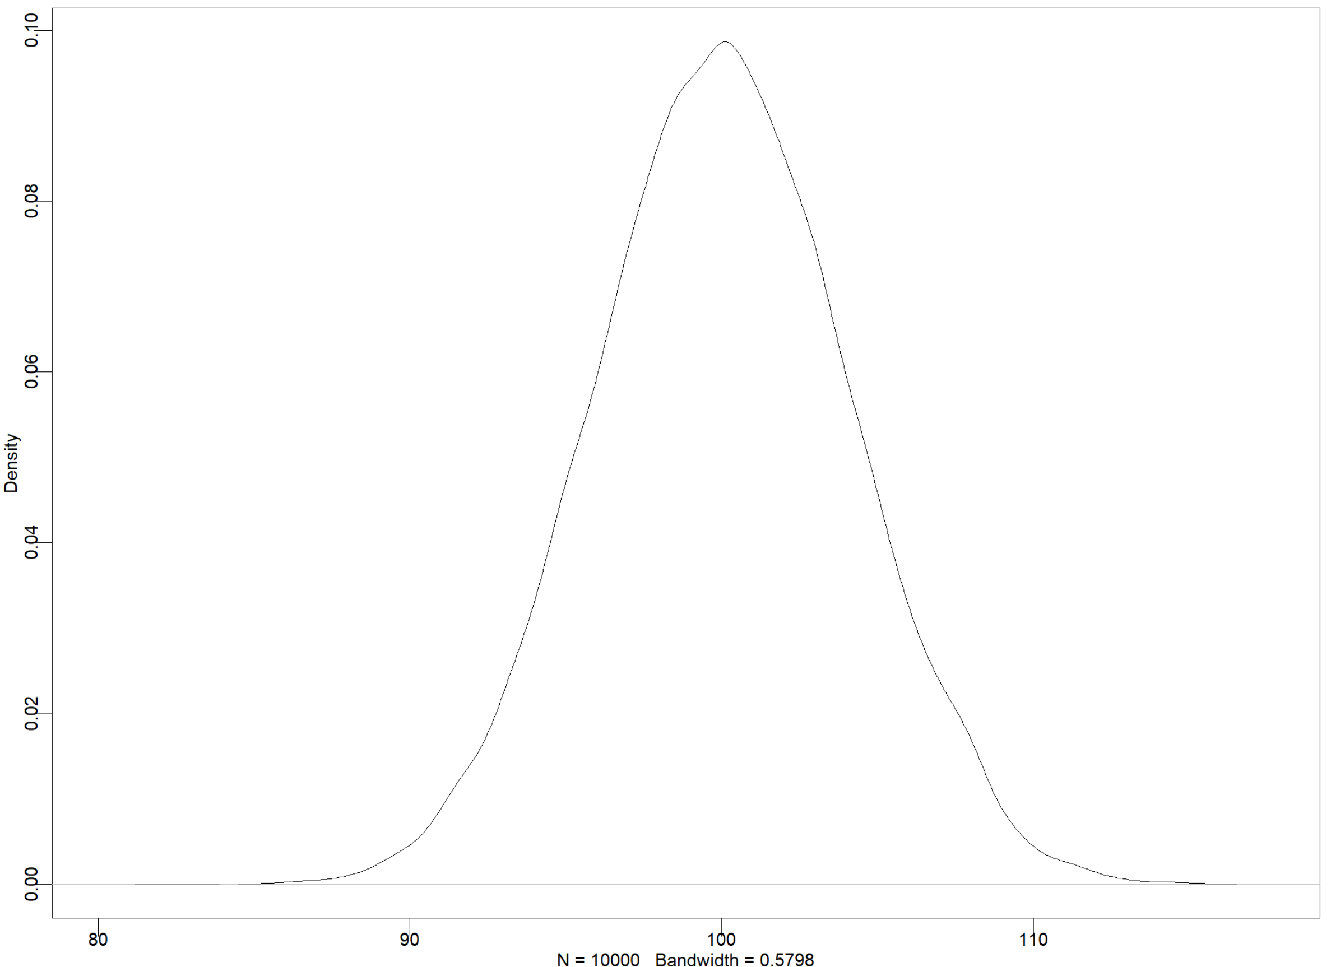
A real world example?
rpois(3000, lambda = 2)
replicate(1000, sum(rpois(3000, lambda = 2)))

Slide 12
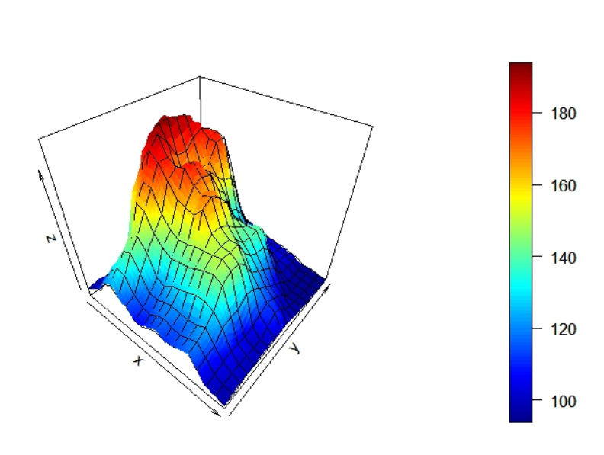

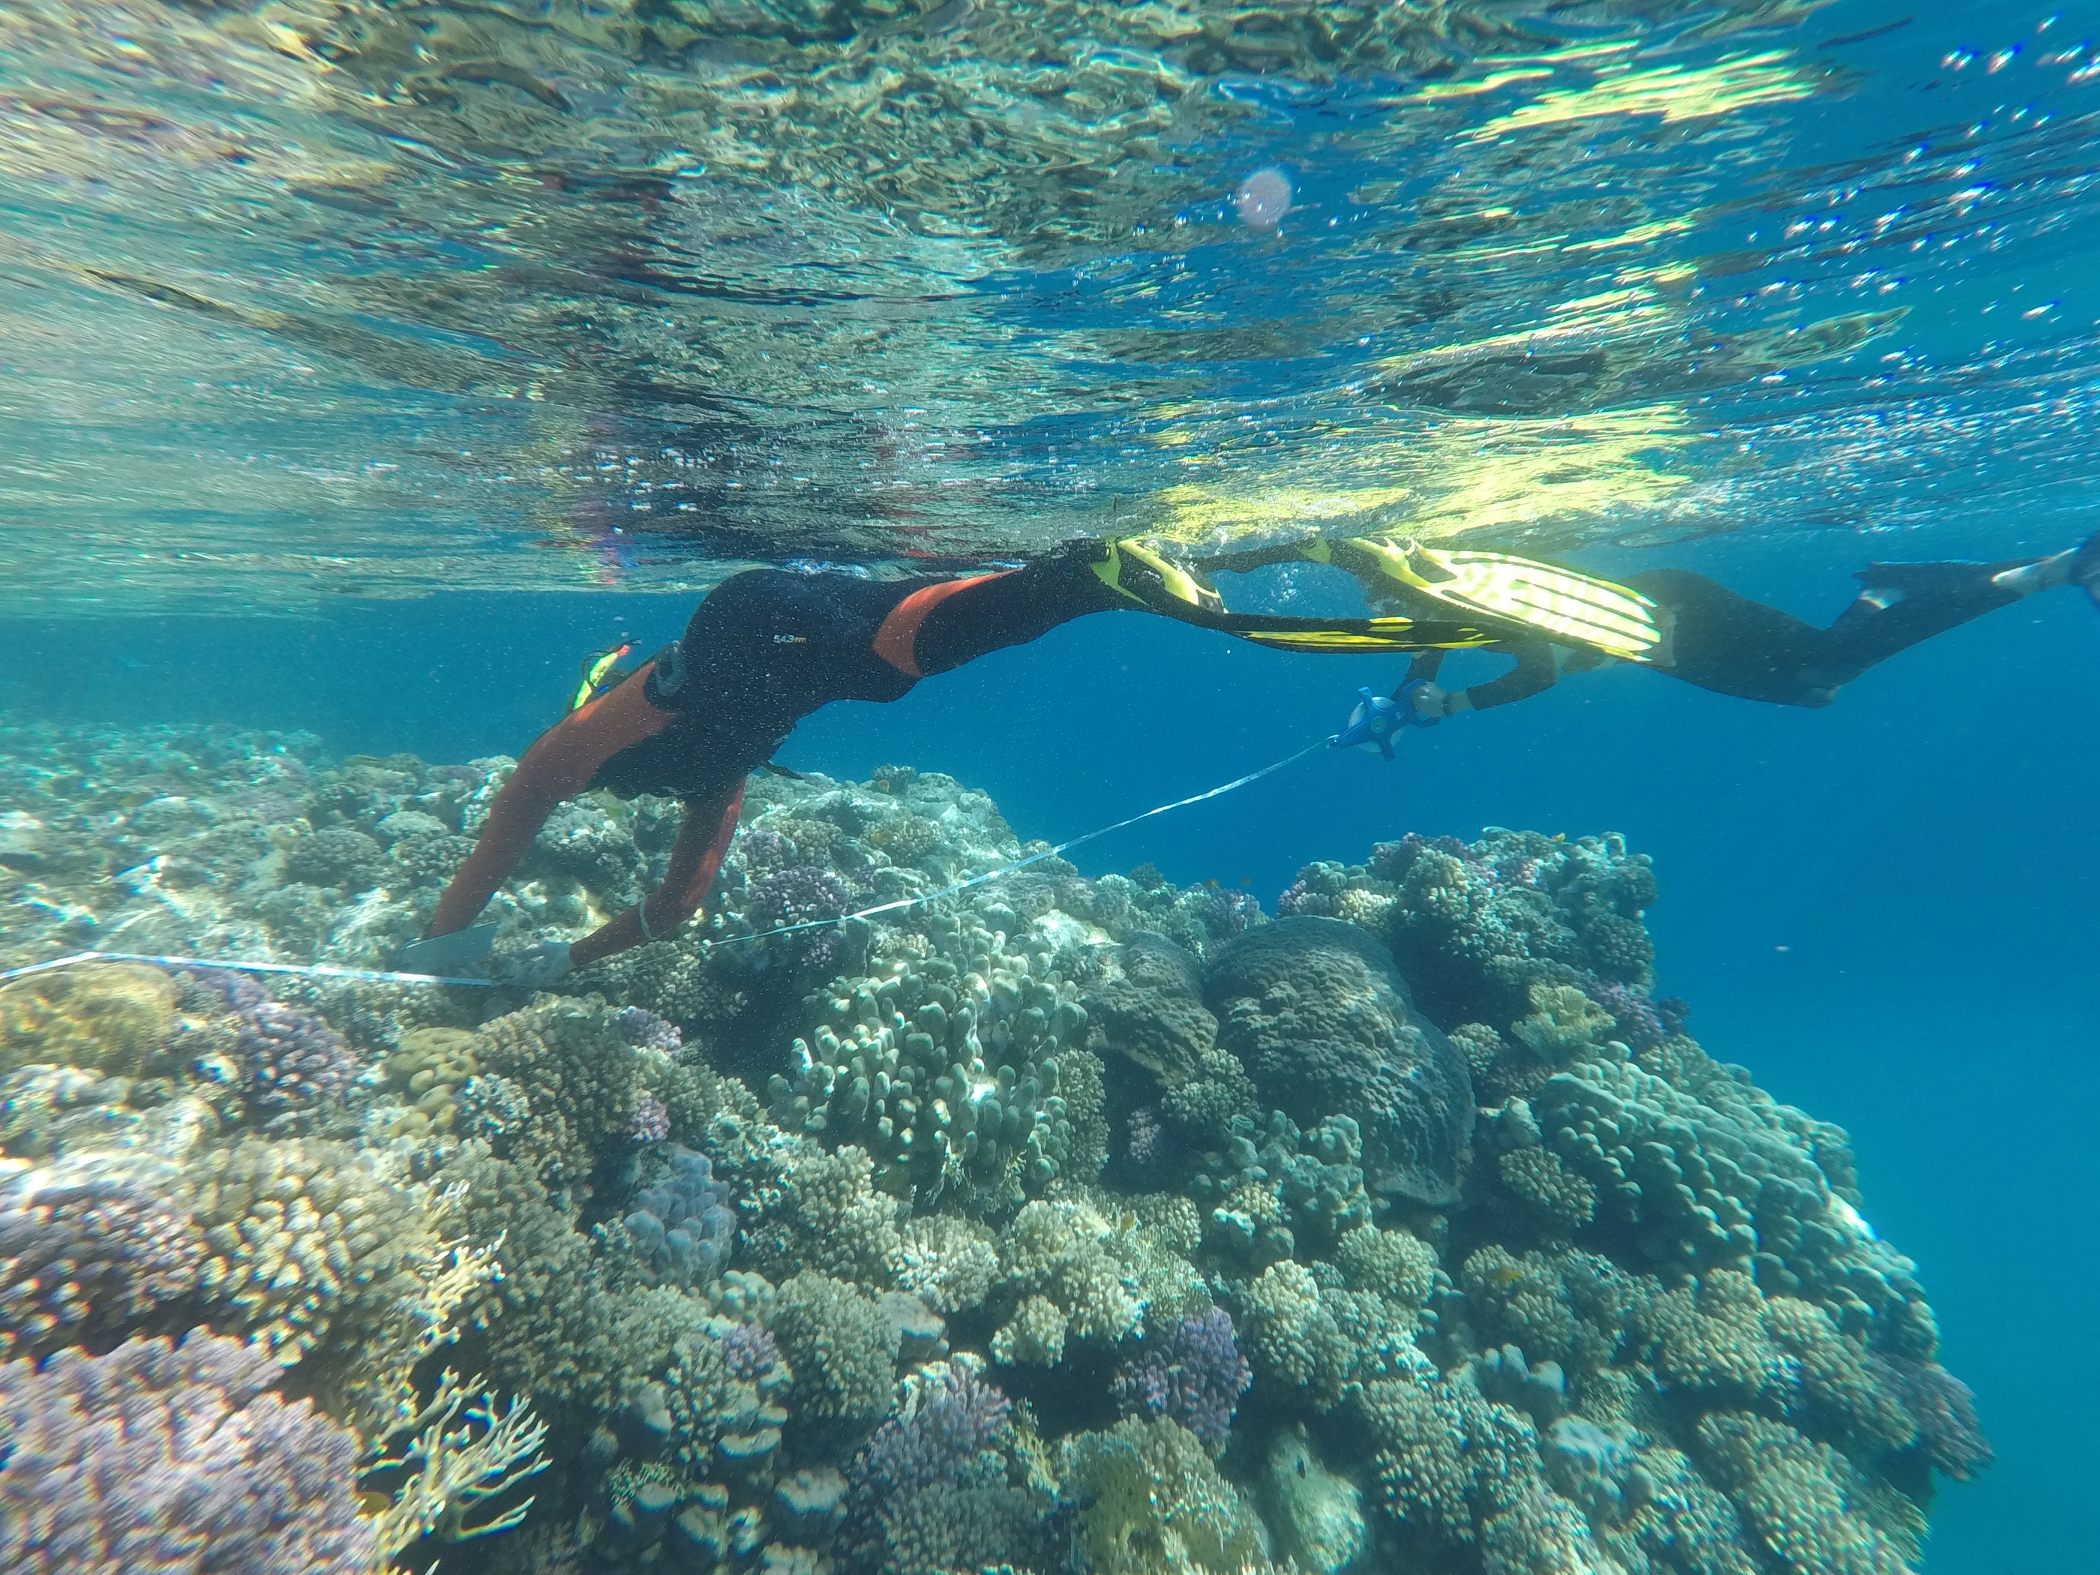
What if we have multiple continuous variables in our model?
Shark abundance
Coral percentage cover
Food availability

Slide 13
High food availability (75% quantile)
Low food availability (25% quantile)
Shark abundance
Coral percentage cover

Slide 14

Summary and questions
Prediction from your model offers several benefits:
Interpretation of models
Display model outputs
Verify model is doing/saying what you think it is
Unlocks the possibility of Cross Validation and predictive modelling
We can use the PGR Stats in R team to discuss and resolve problems

